Slide 1
Lecture #12
SOFT COMPUTING
INT508

Slide 2
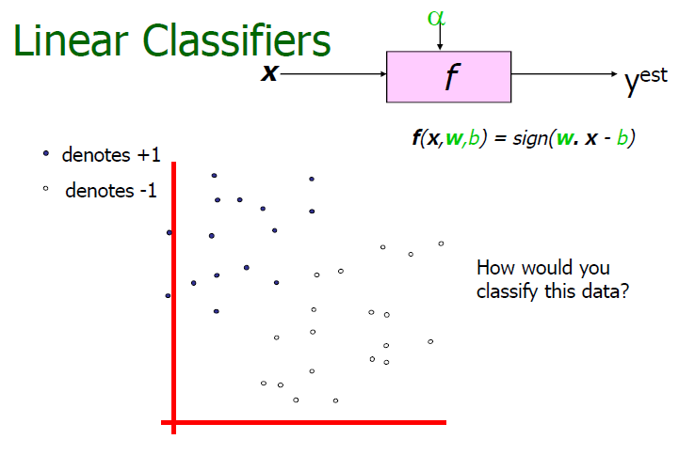
12/12/14
CSE510, Lovely Professional University, Phagwara

Slide 3
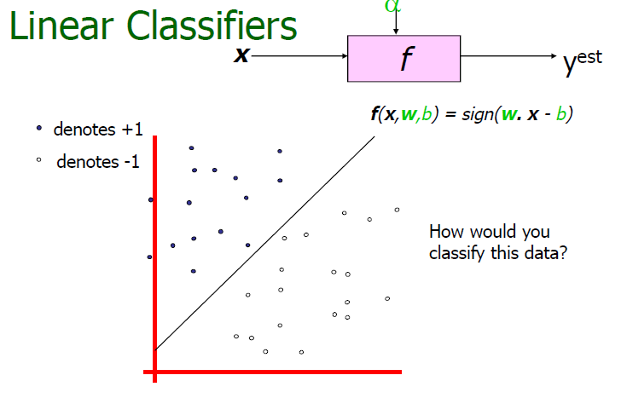
12/12/14
CSE510, Lovely Professional University, Phagwara

Slide 4
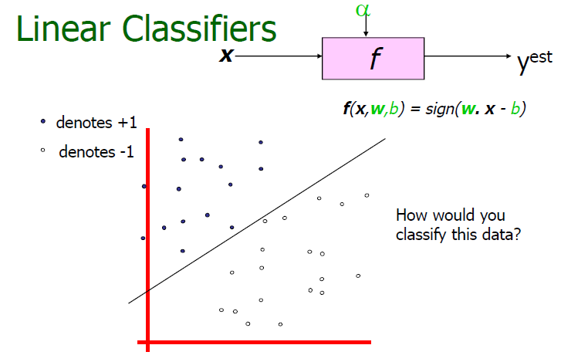
12/12/14
CSE510, Lovely Professional University, Phagwara

Slide 5
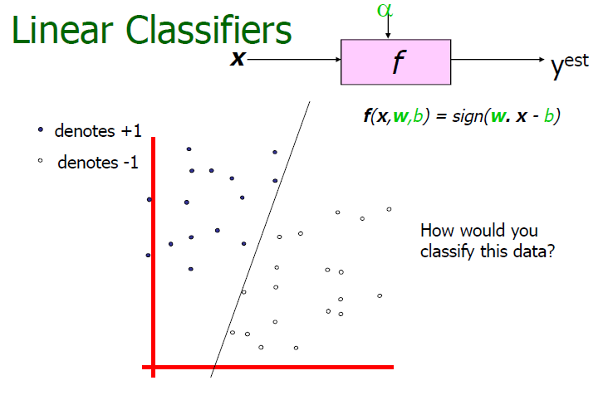
12/12/14
CSE510, Lovely Professional University, Phagwara

Slide 6
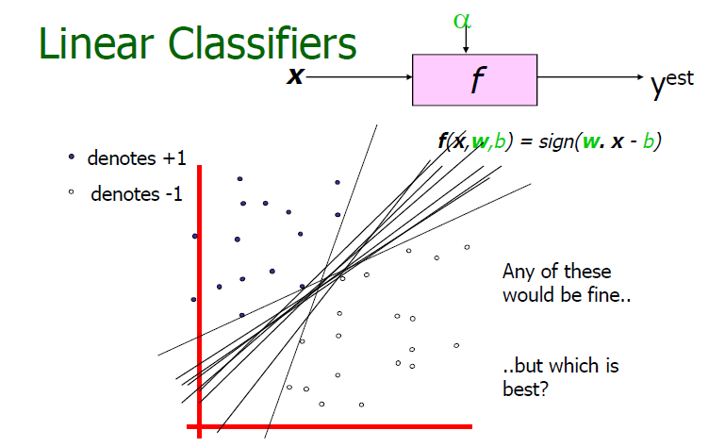
12/12/14
CSE510, Lovely Professional University, Phagwara

Slide 7
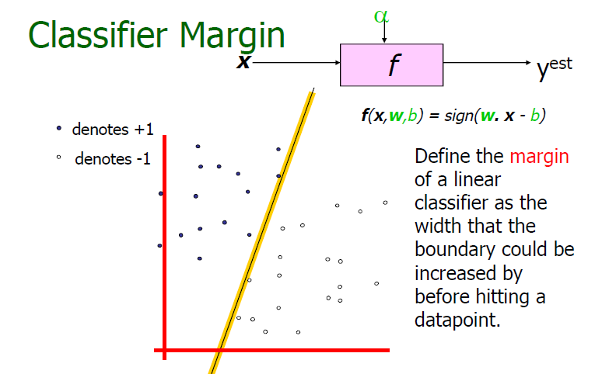
12/12/14
CSE510, Lovely Professional University, Phagwara

Slide 8
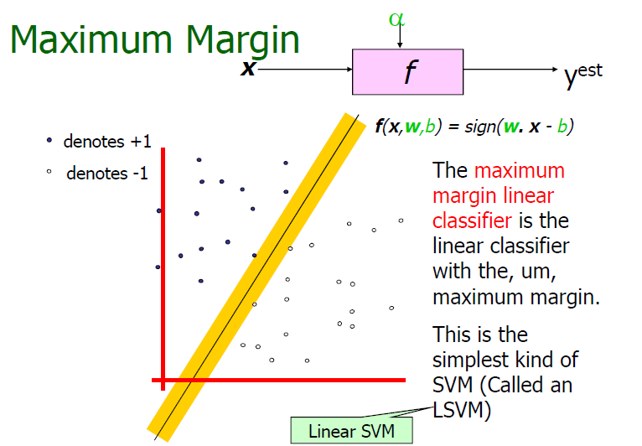
12/12/14
CSE510, Lovely Professional University, Phagwara

Slide 9
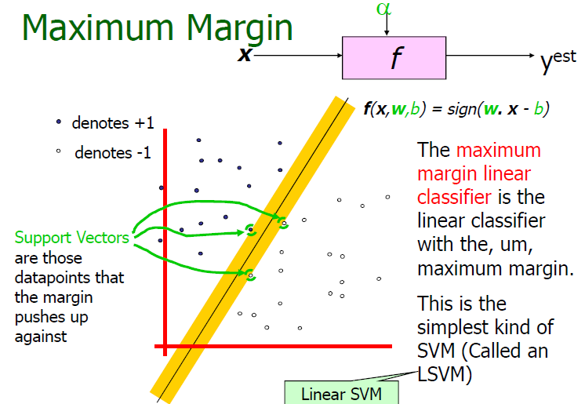
12/12/14
CSE510, Lovely Professional University, Phagwara

Slide 10
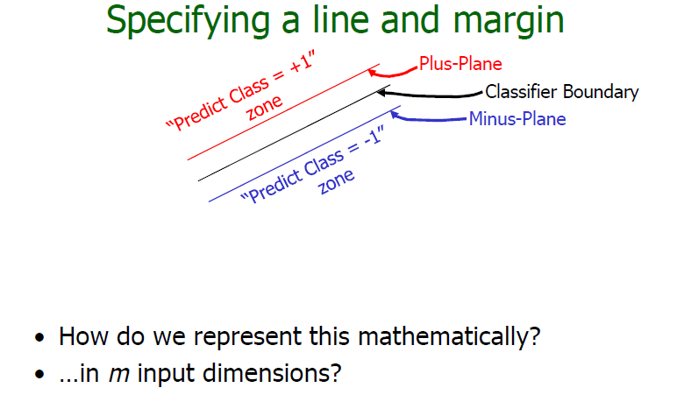
12/12/14
CSE510, Lovely Professional University, Phagwara

Slide 11
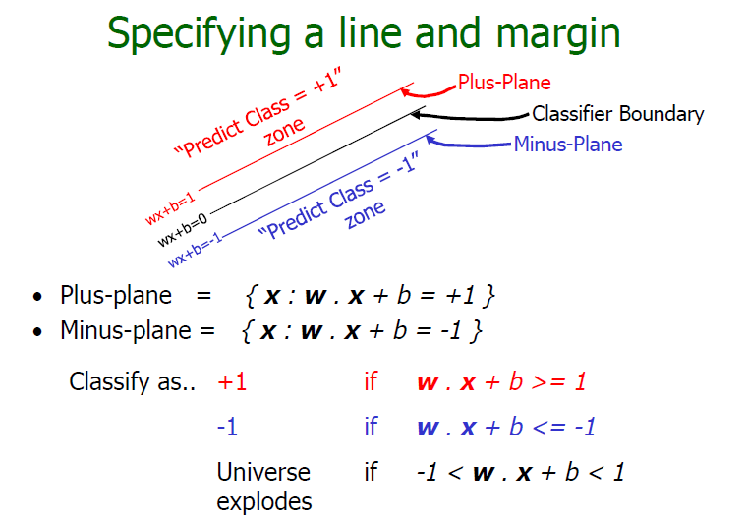
12/12/14
CSE510, Lovely Professional University, Phagwara

Slide 12
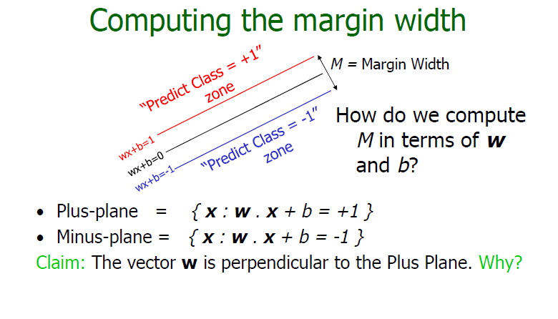
12/12/14
CSE510, Lovely Professional University, Phagwara

Slide 13
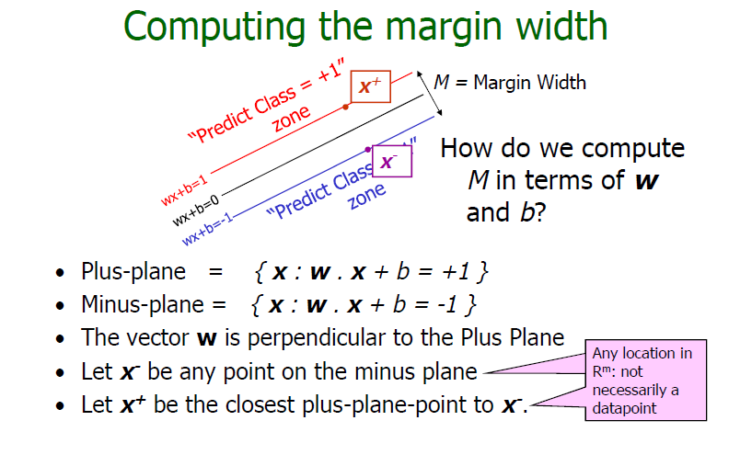
12/12/14
CSE510, Lovely Professional University, Phagwara

Slide 14
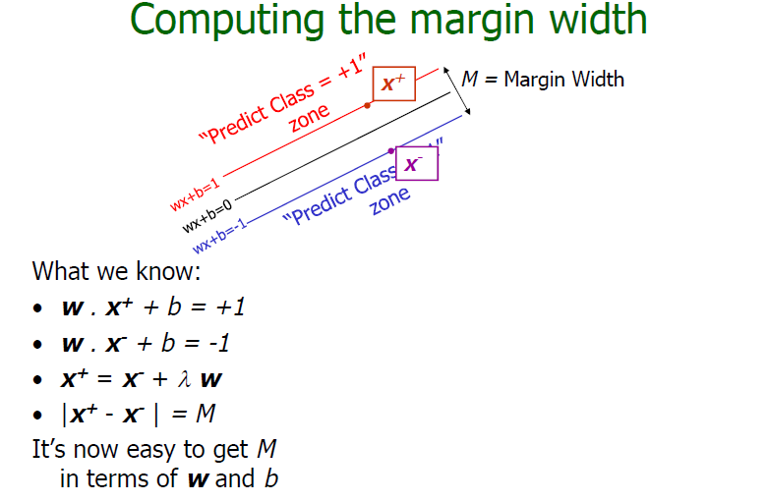
12/12/14
CSE510, Lovely Professional University, Phagwara

Slide 15
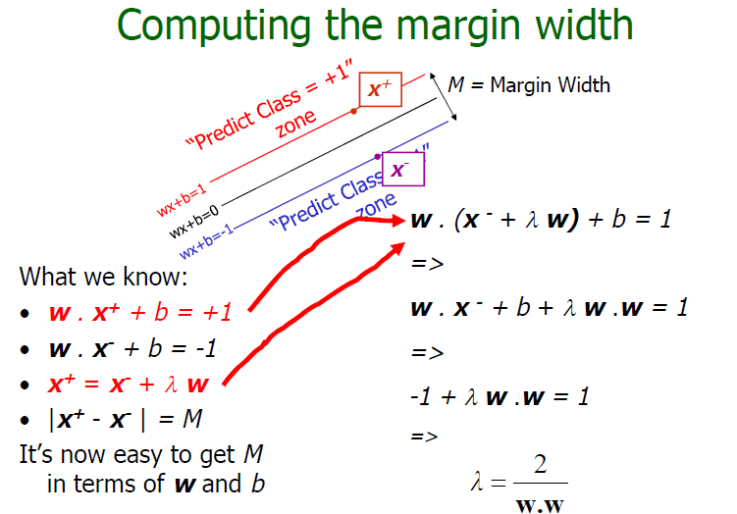
12/12/14
CSE510, Lovely Professional University, Phagwara

Slide 16
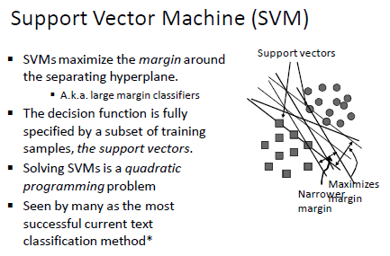
12/12/14
CSE510, Lovely Professional University, Phagwara

Slide 17
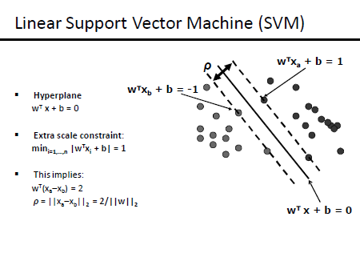
12/12/14
CSE510, Lovely Professional University, Phagwara

Slide 18
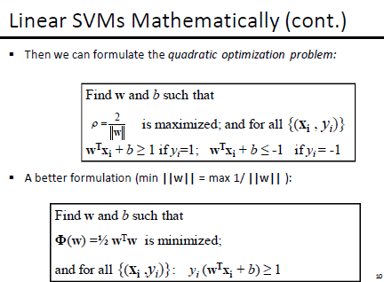
12/12/14
CSE510, Lovely Professional University, Phagwara

Slide 19
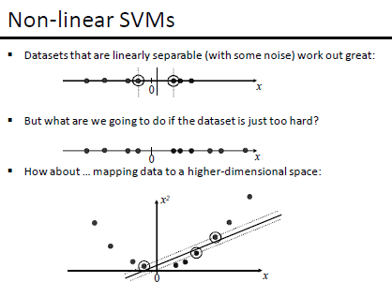
12/12/14
CSE510, Lovely Professional University, Phagwara

Slide 20
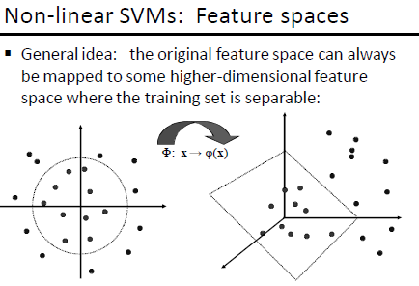
12/12/14
CSE510, Lovely Professional University, Phagwara

Slide 21
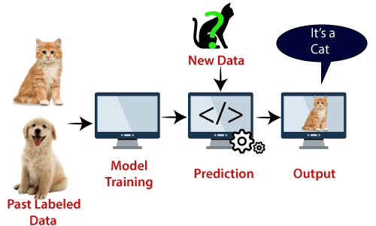
12/12/14
CSE510, Lovely Professional University, Phagwara

Slide 22
1. Support Vector Machine (SVM) can be used for _____.
(A) classification only
(B) regression only
(C) classification and regression both
(D) None of these
12/12/14
CSE510, Lovely Professional University, Phagwara

Slide 23
1. Support Vector Machine (SVM) can be used for _____.
(A) classification only
(B) regression only
(C) classification and regression both
(D) None of these
12/12/14
CSE510, Lovely Professional University, Phagwara

Slide 24
2. In SVM, the dimension of the hyperplane depends upon which one?
(A) the number of features
(B) the number of samples
(C) the number of target variables
(D) All of the above
12/12/14
CSE510, Lovely Professional University, Phagwara

Slide 25
2. In SVM, the dimension of the hyperplane depends upon which one?
(A) the number of features
(B) the number of samples
(C) the number of target variables
(D) All of the above
12/12/14
CSE510, Lovely Professional University, Phagwara

Slide 26
3. In SVM, if the number of input features is 3, then the hyperplane is a _____.
(A) line
(B) circle
(C) plane
(D) None of these
12/12/14
CSE510, Lovely Professional University, Phagwara

Slide 27
3. In SVM, if the number of input features is 3, then the hyperplane is a _____.
(A) line
(B) circle
(C) plane
(D) None of these
12/12/14
CSE510, Lovely Professional University, Phagwara

Slide 28
4. In SVM, what is a hyperplane?
(A) decision boundaries
(B) data points
(C) features
(D) None of these
12/12/14
CSE510, Lovely Professional University, Phagwara

Slide 29
4. In SVM, what is a hyperplane?
(A) decision boundaries
(B) data points
(C) features
(D) None of these
12/12/14
CSE510, Lovely Professional University, Phagwara

Slide 30

12/12/14
CSE510, Lovely Professional University, Phagwara

